Slide 1

Weather Temperature Forecasting on Jena Climate data - Time series
Group Members:
Dinesh Chandra Gaddam

Slide 2
Project Overview
Scope of the Project
•⁠ ⁠Develop the best possible model using Arma, ARIMA, SARIMA or Box-Jenkins to forecast Temperature
•⁠ ⁠Perform all the required analysis on pretrained and post-trained data
Understanding the concepts and underlying methodology of the data

Slide 3
Data Source
Public Datasets: Use dataset from Kaggle named Jena Climate Data. Data used of period 2009 to 2012.

Slide 4

Project content
•⁠ Data Collection and Preprocessing
•⁠ Stationarity Check and Seasonal Decomposition
•⁠ ⁠Feature Selection and Base Models
•⁠ ⁠Model Development
•⁠ ⁠Model Evaluation
•⁠ Forecasting
•⁠ Deciding best model
•⁠ Summary

Slide 5
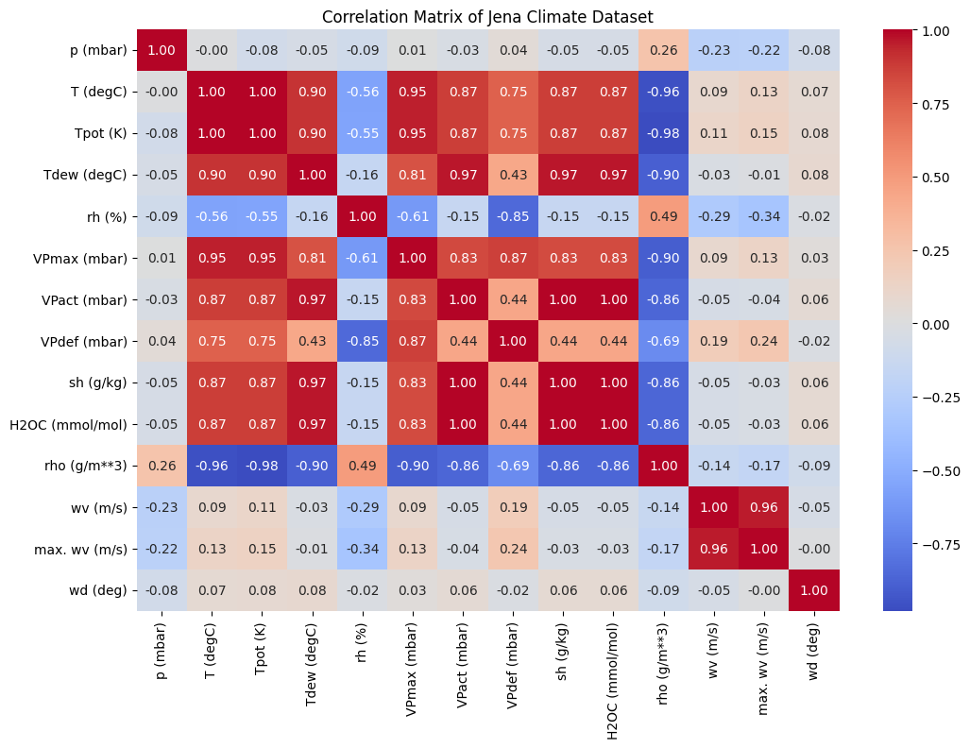
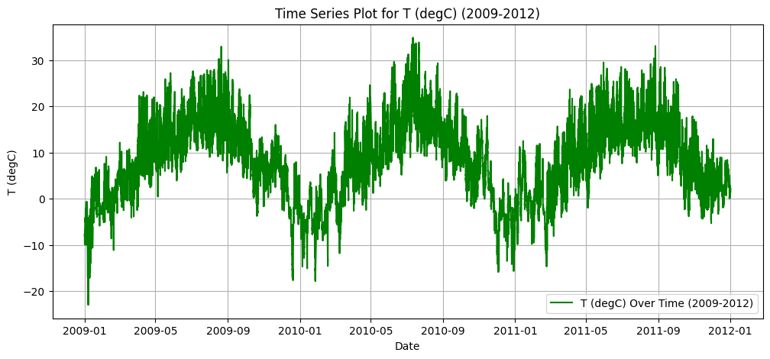
⁠ Data Collection and Preprocessing
I have Limited Data to 3 years from 2009 to 2011 to make the data flexible to work with

Slide 6
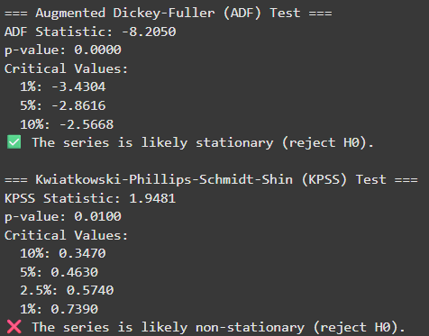
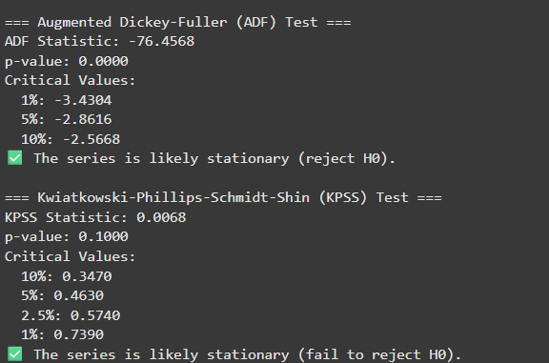
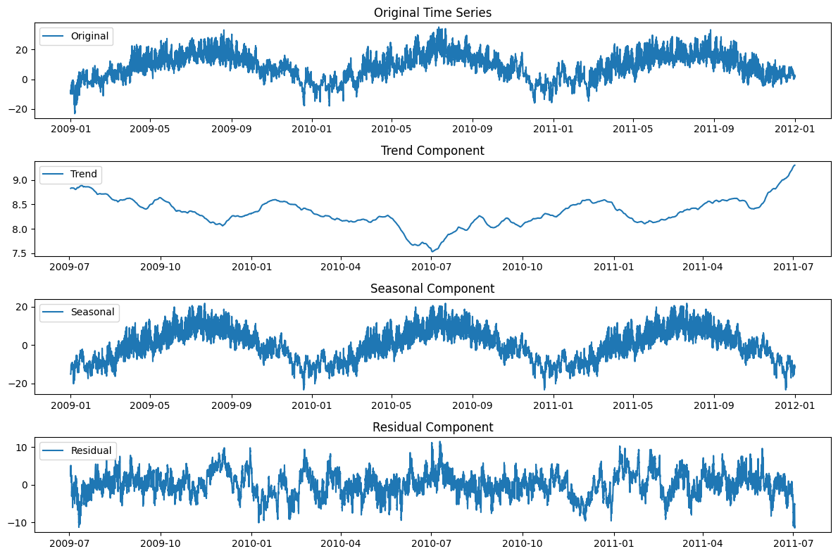
Stationarity Check and Seasonal Decomposition
Before differencing After Differencing
The Data is Seasonal: with 87% seasonality

Slide 7
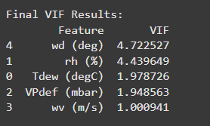
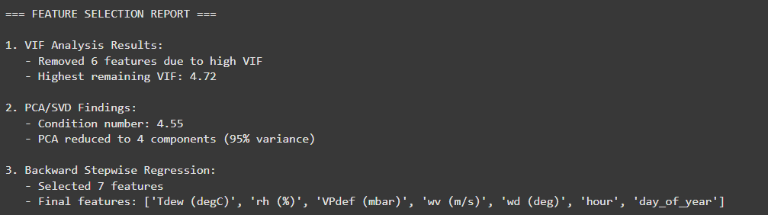
⁠Feature Selection and Base Models

Slide 8
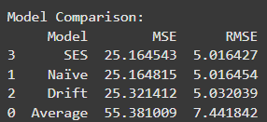
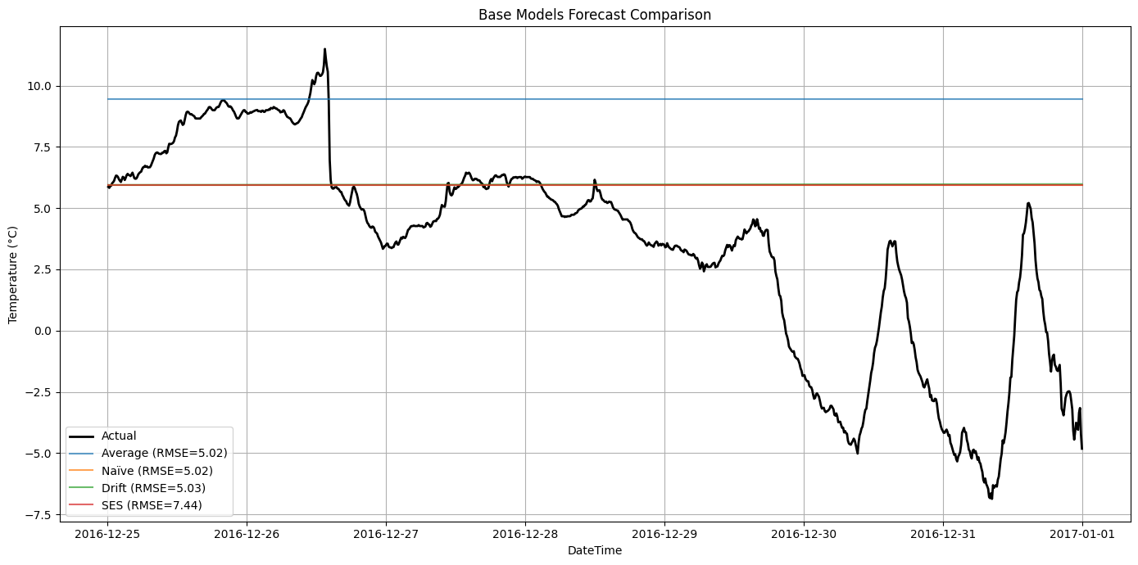
⁠Feature Selection and Base Models

Slide 9
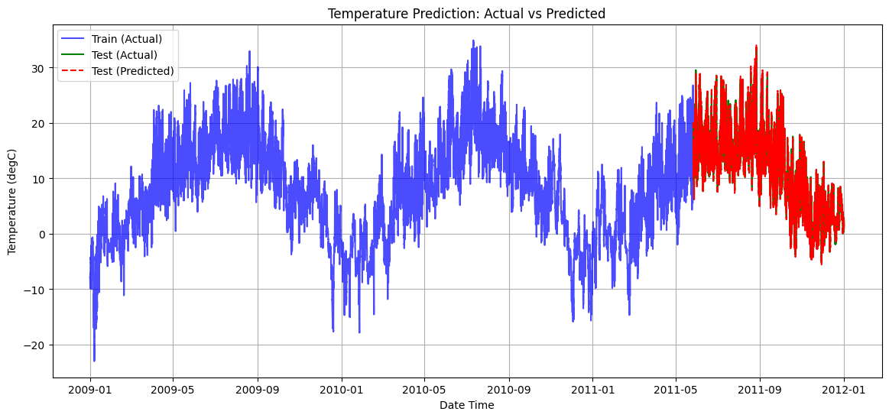
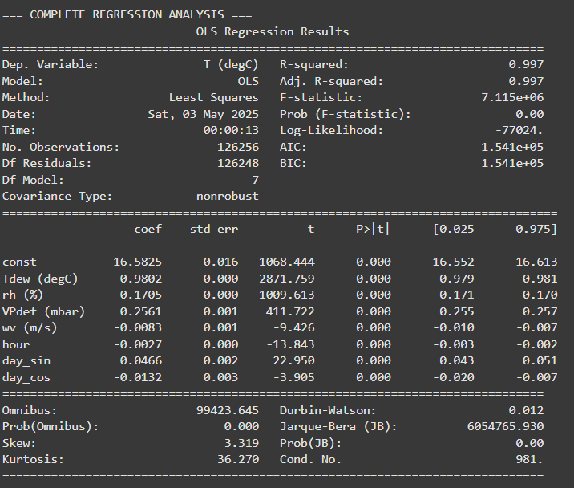

Model Development
Multiple Linear Regression

Slide 10
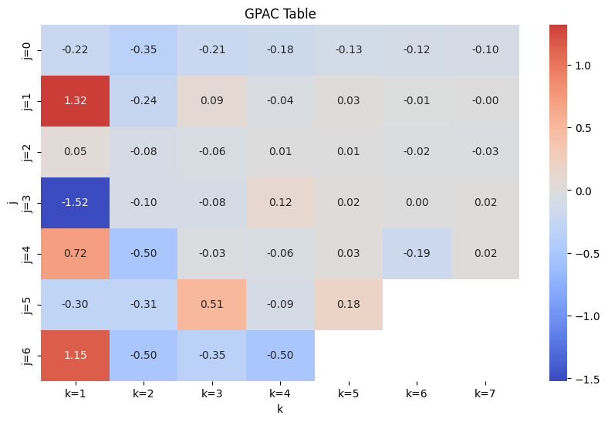
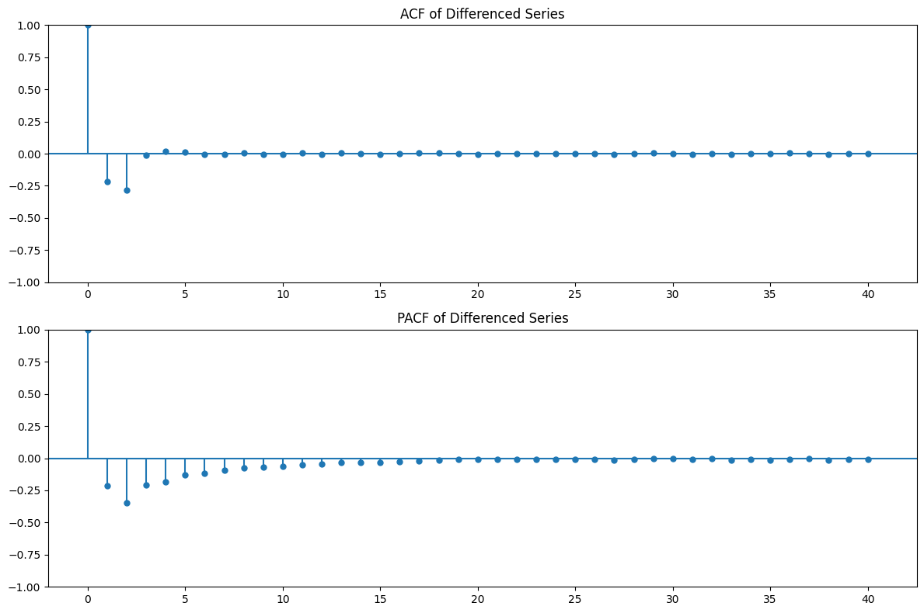

Model Development
GPAC, PACF and ACF of the Stationary data, expecting order of AR: 0 or 2 and MA order of 2

Slide 11
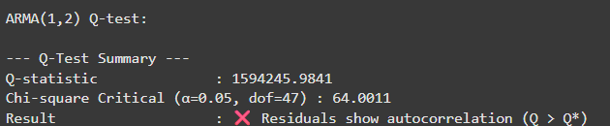
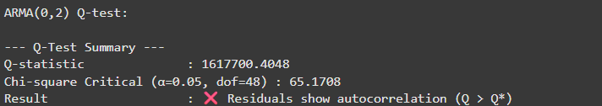
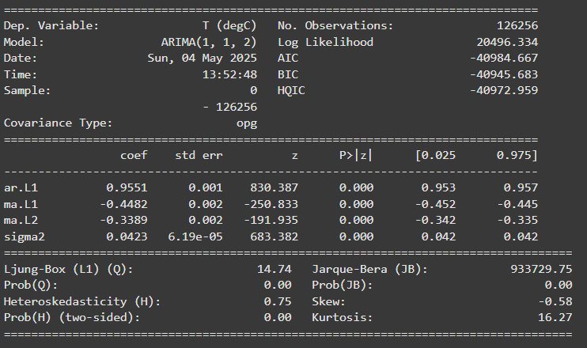
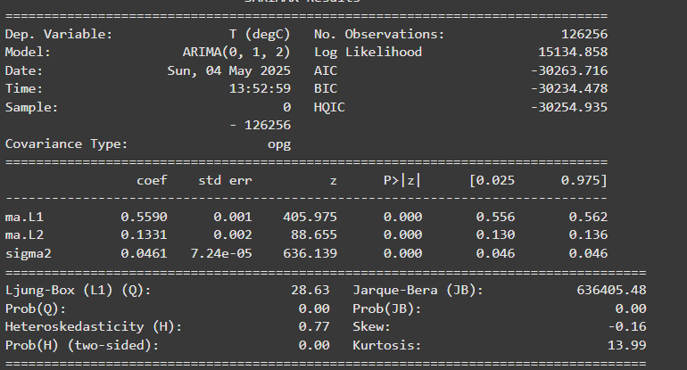


ARMA observations
ARIMA Observations

Slide 12
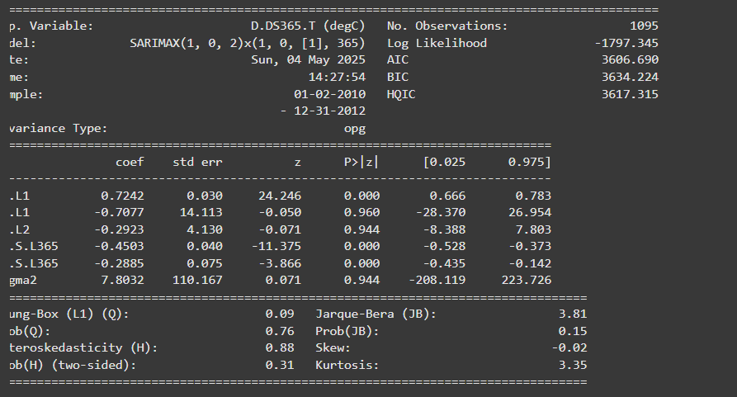
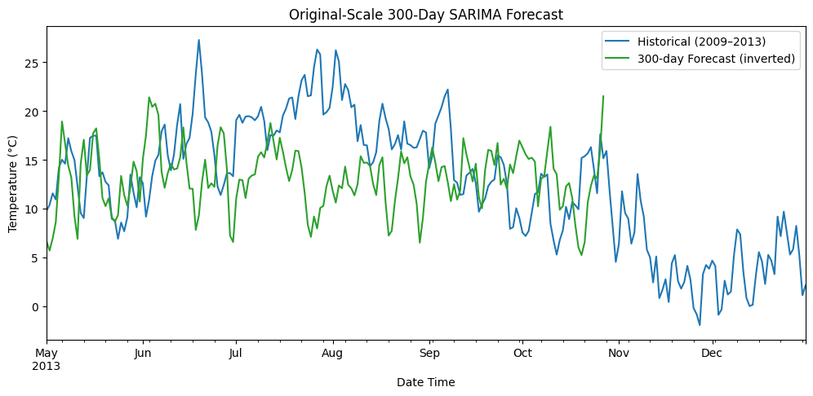
SARIMA observations for its best model..
Observation: the model captures the seasonality but there is almost 0 trend in my data. So the model was unable to access the right movement. To solve this issue I used
ARIMA(0,1,2) on Seasonally‐Adjusted Data + Seasonal Recomposition Forecast

Slide 13
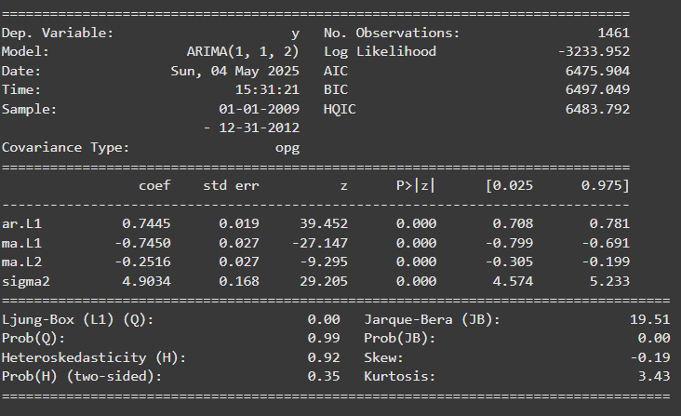

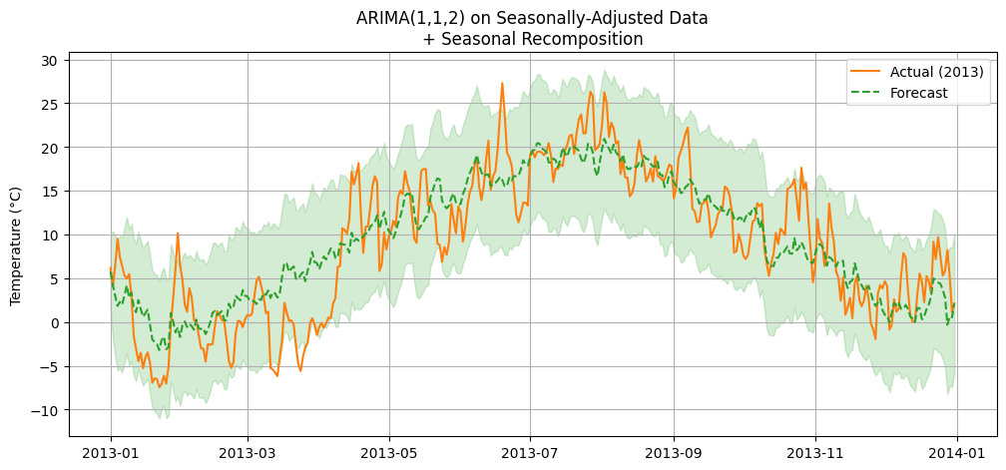
ARIMA(0,1,2) on Seasonally‐Adjusted Data + Seasonal Recomposition Forecast
365 step forecast of the resampled data=>

Slide 14
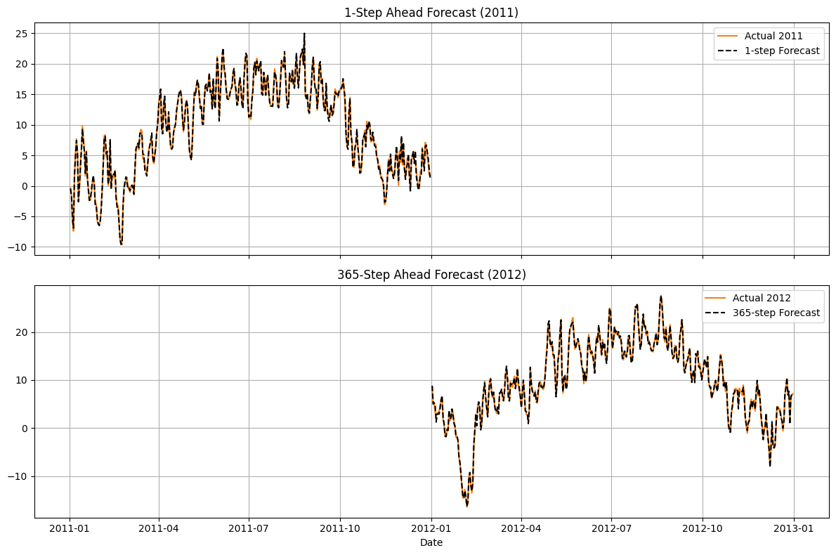
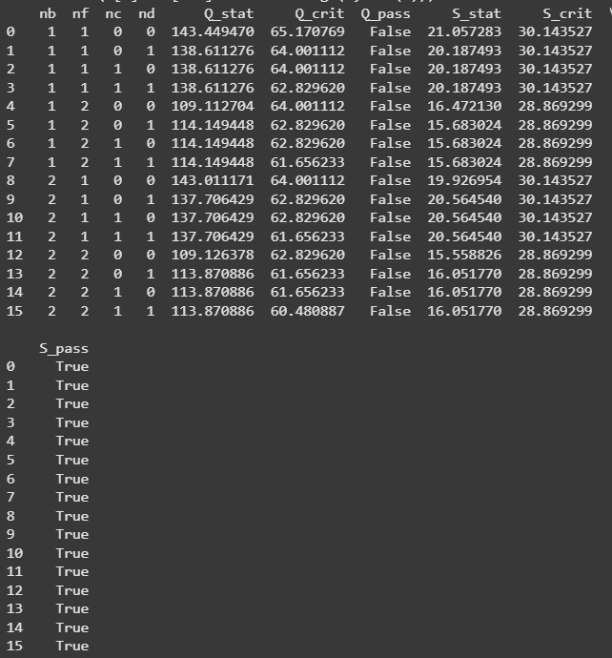
Box-Jenkins
Q-test: Q=143.0, crit=64.0, df=47 -> ❌ autocorrelation
S-test: S=19.9, crit=30.1, df=19 -> ✅ G(q) accurate

Slide 15
Summary
•⁠ The Models have been built for ARMA, ARIMA, SARIMA, BOX-Jenkins etc:- al from all of them Box-Jenkins Has performed the best..
•⁠ I have derived the order from GPAC, PACF and ACF plots by feeding them the stationary data..
•⁠ The model received a accuracy of RMSE of 0.360 for the normalised data after making it stationary…
References
Notes and Assignments

Slide 16
Thank you!

